Slide 1
IMPORTING & EXPORTING DATA IN R

Slide 2
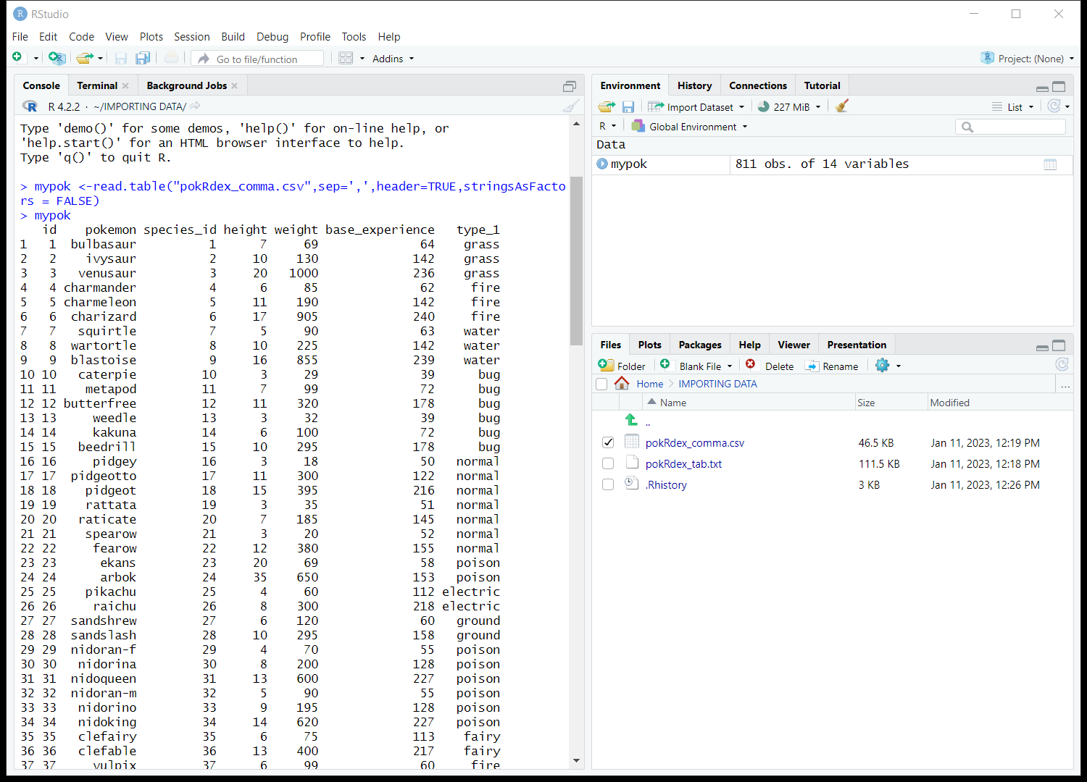
read.table(“file.name”,sep=, header=, stringsAsFactors=)
Reads a file in table format and creates a data frame for it.
Use the type of separator(sep), whether it has a header or not (header), thirdly whether R should consider the strings as Factors.
Before doing this , set the current working directory using setwd()
Getwd() gets the current working directory
For csv files sep=‘,’’
We set stringsasfactors to
FALSE as my column contains
Variable names(pokemon col)

Slide 3
Reading a csv file
read.csv(“file.name”, stringsAsFactors=) reads a csv file and creates a data frame from it.
?read.delim- Shortcut to loading tab –delimited files
If read.csv doesn’t work or if the notation for a decimal is a comma where you are then use read.csv2
Also Data from external sources have additional text
In order to ignore it we need read.csv(….skip =n) skips the specified number of rows when importing data
Nrows refers to rows of observation.

Slide 4
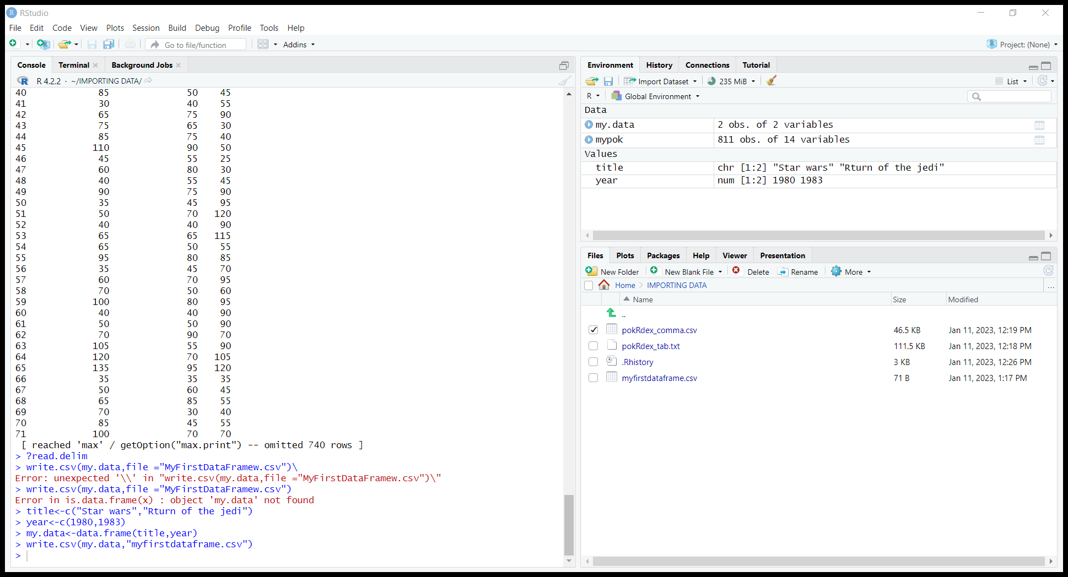
Writing a csv file
In addition set row.names = FALSE
If u set row.names =TRUE it will add another column to the front marking each row from 1 to n

Slide 5
Exercise:
Download the employees dataset from the resources for this lesson.
Then, import it into R using your preferred import method.
This is a large dataset, so limit the import to 200 observations. Note that the dataset has Copyright information in the beginning (23 rows). Any character variables should be stored as characters.
Rename the variables as follows: "Employee number", "First name", "Last name", "Birth date", "Gender", "Job title", "Salary", "From date", "To date".
Export the data set you currently have as a CSV, without saving the row names.
Import it back again to make sure everything is okay

Slide 6
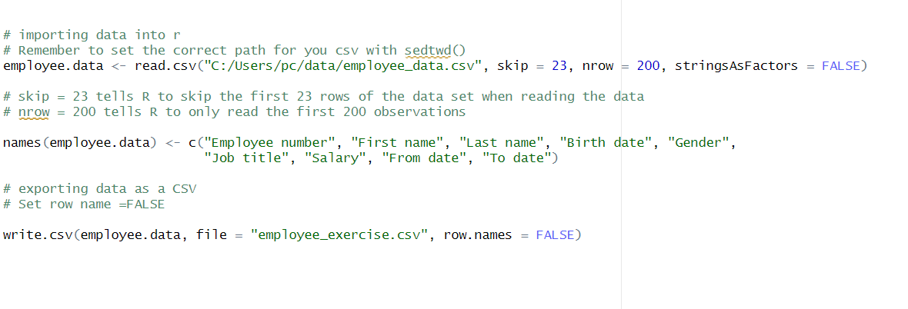
Solution

